Slide 1

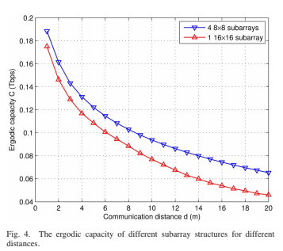
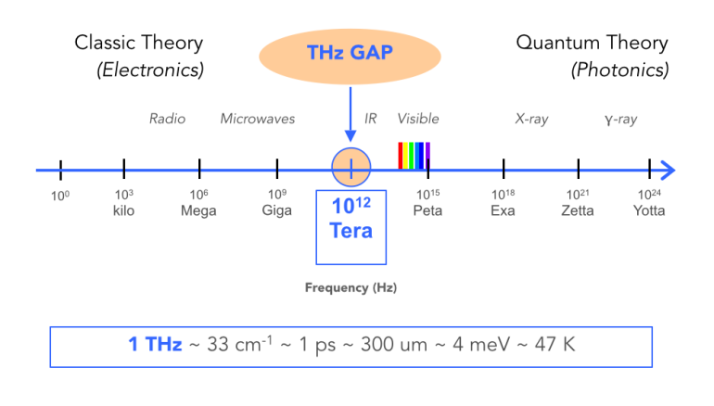
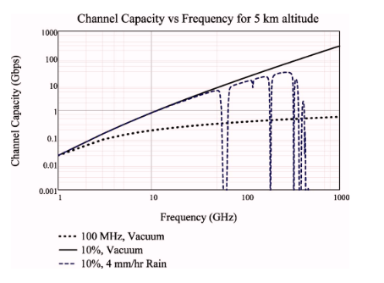
Data Communication via T-rays
Waves Occupying the Spectrum Slot Between Radio Waves and Light
CNT 4514C Wireless Networks and Mobile Computing
Spring 2019
Professor: Zornitza Genova Prodanoff
ABSTRACT
INTRODUCTION
Future uses of T-rays
This poster explains how Terahertz Waves (T-rays) are emerging in wireless communications that allow higher capacity channels and data rates for point-to-point communication. Currently T-rays are being used for unique situations, such as in the medical sector (e.g. X-rays) and the security sector. However its utility as a data communication medium is not being taken advantage of. As the quantity of data being transferred is increasing exponentially, this paper highlights various experiments that try to discover if T-rays can solve this problem. The poster also discusses the potential impacts of the environment on the effectiveness of T-rays. For example, how rain or obstacles may impact the data rates when communicating via T-rays.
While you may have never heard of Terahertz Waves or T-rays for short, they have been known to researchers for the past 60 years. T-rays can be seen on the electromagnetic spectrum between microwaves and visible light as seen in Figure 1. They have a large range of frequencies, from around 1 millimeter to 30 micrometers or what may be more familiar to the average reader as 100 GHz to 3 THz range (shown Figure 1). The use of T-rays are not new to NASA either. They have used them in the past to send data down to Earth from satellites. T-rays were also used to inspect the atmospheres of other planets.
Unlike wireless signals in other portions of the spectrum, T-rays are able to pass through some materials such as plastic and wood yet achieving an adequate signal range for the purpose of wireless LAN implementation is a challenge. Those unique qualities of the wave gives it the possibility to be used for security reasons as well. In one application, for example, it would be possible to see the contents of a package or cargo without the need to look inside. Similar to what X-ray machines achieve at airport security checks.
T-rays could also be used as the new standard for wireless communication in the future. Experiments have shown that is possible to have 1.5 Gbit/s speeds using T-rays. This is a major improvement over the standard wireless protocols used daily by everyone around the world.
Future uses of this technology rely on the need for higher capacity channels. As the need for these high capacity channels increase, the need to T-rays will also increase. The University of Electronic Science and Technology of China conducted an experiment to determine if THZ will be a valid solution to the exponential increase in wireless network traffic. The experiment measured transmission system performance and the noise performance is analyzed in terms of output signal to noise ratio [2]. The experiment concluded that THZ would be a valid way to increase bandwidth when compared to current methods. A data rate of 10 Gbit/s was successfully transmitted using the transceiver in the experiment. This mean that is thought that THZ is a valuable technology that can be used in the future for increasing bandwidth over wireless communications [2]. This proves that T-rays could be used in the future to solve the issue of increasing wireless communication.
Figure 3: Channel capacity indoors. [3]
Summary
In conclusion, the study conducted by the University of Electronic Science and Technology of China determined that T-rays are a valid solution to the problem of increasing channel capacity. However the distance that T-rays can travel are much less than technologies that are currently used. Another Chinese experiment testing data rates of T-rays showed that speeds10 Gbit/s were possible. This is an extremely good result for communication via a wireless medium. Depending on the implementation, transmission loss is common in THz communication using metal transmission lines that shorten the length data can travel. All these experiments are proof of concept, T-rays are not being used in any type of major capacity for communication.
CONTACT
Current State of T-rays
As the number to wireless signals is increasing exponentially, the amount of data that is being sent wirelessly is also expanding. Mobile data traffic is expected to increase sevenfold between 2016 and 2021, whereas video traffic is anticipated to experience a threefold increase during the same time period [1]. Current technologies are not able to offer the bandwidth required in the future. It is possible that T-rays will allow a capacity of Terabits per second [1]. This advantage of T-rays has been taken advantage of in the medical and security sector already. T-rays have a lower frequency range than X-rays, allowing it to be able to detect different features in imaging. One such example of this is the detection of water content and density of a tissue. The security sector uses T-rays to detect items covers by fabric or plastic. For example, the police can detect concealed weapons, protecting them from unnecessary harm. Even though these example of uses are interesting, T-rays have not been widely adopted on a global scale. Only small use cases have currently been established. This is because of the damage it can cause to human tissue.
Figure 1: T-rays shown on the electromagnetic spectrum [6]
Francis Rukab
Email: n00961805@ospreys.unf.edu
Phone: 904-401-9068
Michael Moser
Email: n00976174@osprys.unf.edu
Phone: 904-517-2896
Johlani Bryant
Email: n01242401@opsreys.unf.edu
Phone: 301-806-9366
REFERENCES
[1] J. Federici and Lothar, “Review of terahertz and subterahertz wireless communications,” Host Needed, 09-Nov-2009. [Online]. Available: https://login.dax.lib.unf.edu/login?url=http://search.ebscohost.com/login.aspx?direct&db=aci&AN=501615027&site=eds-live&scope=site.
[2] Z. Chen, B. Zhang, and Y. Fan, “Sub-terahertz transmission experiment for future wireless high speed data communication,” UNF Thomas G. Carpenter Library Off-Campus Access, 13-Oct-2016. [Online]. Available: https://ieeexplore-ieee-org.dax.lib.unf.edu/document/7588316.
[3] C. Lin and G. Y. Li, “Indoor Terahertz Communications: How Many Antenna Arrays Are Needed?,” UNF Thomas G. Carpenter Library Off-Campus Access, 09-Feb-2015. [Online]. Available: https://ieeexplore-ieee-org.dax.lib.unf.edu/document/7036065.
[4] A. Hirata and M. Yaita, “Ultrafast Terahertz Wireless Communications Technologies,” UNF Thomas G. Carpenter Library Off-Campus Access, Nov-2015. [Online]. Available: https://ieeexplore-ieee-org.dax.lib.unf.edu/document/7335434.
[5] H. Elayan, O. Amin, R. M. Shubair, and M.-S. Alouini, “Terahertz communication: The opportunities of wireless technology beyond 5G,” UNF Thomas G. Carpenter Library Off-Campus Access, 17-Apr-2018. [Online]. Available: https://ieeexplore-ieee-org.dax.lib.unf.edu/document/8360286.
[6] “Is the world ready for T-rays?,” ideas.ted.com, 13-Sep-2016. [Online]. Available: https://ideas.ted.com/is-the-world-ready-for-t-rays/.
Figure 2: Channel capacity versus frequency at high altitudes. [1]

